Slide 1
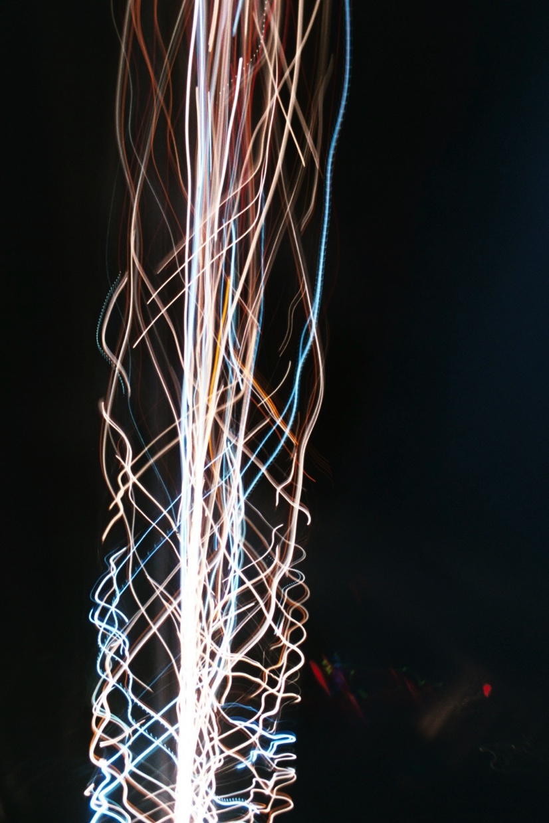
Writing Songs with FFT derived chords fed to Markov Model
Christian Adams &
Devan Corcoran

Slide 2
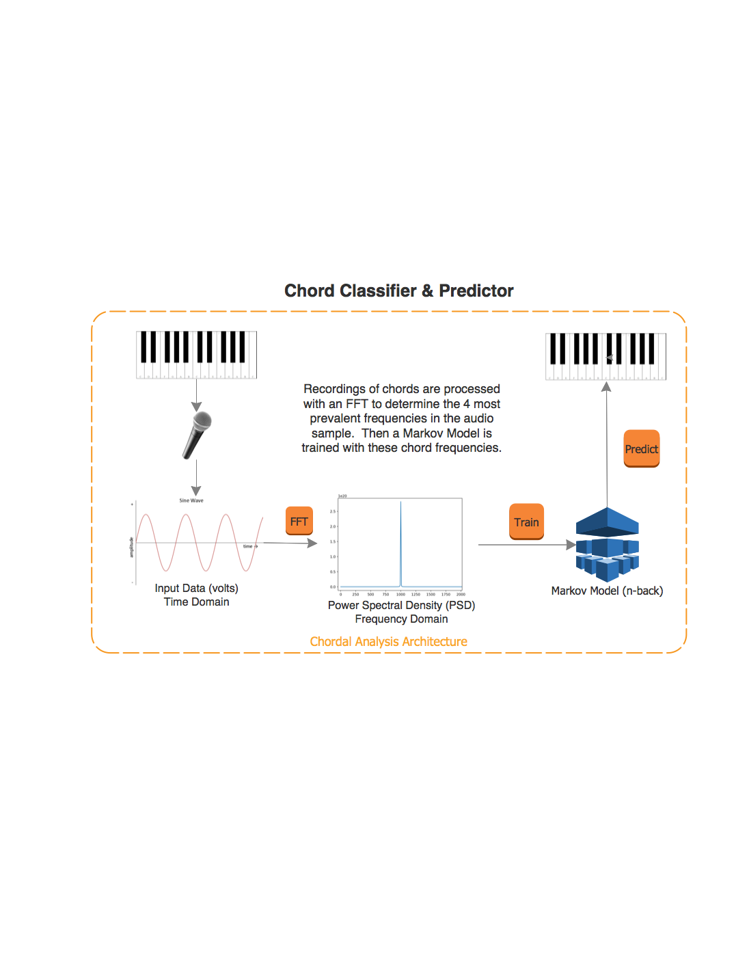

Slide 3
Background: Music Theory
The language of music is notes.
When notes are played at the same time, they are called chords.
Many chords in sequence makes up a song. Songs are made more interesting by varying how these chords are played (rhythm, articulation, tone, arppegiation, etc.)

Slide 4
Background: Acoustics
When a note is played, or generated by a sine tone generator, it can be recorded and represented as a voltage signal, which when graphed is called a waveform.

Slide 5
Waveforms
Waveform
Waveform (Zoomed In)

Slide 6
Background: Acoustics
Waveforms of individual sine waves
Waveforms of combined sine waves

Slide 7
?
How did that sine wave get so complex?
An FFT breaks apart that complicated waveform into each of its’ component frequencies.

Slide 8
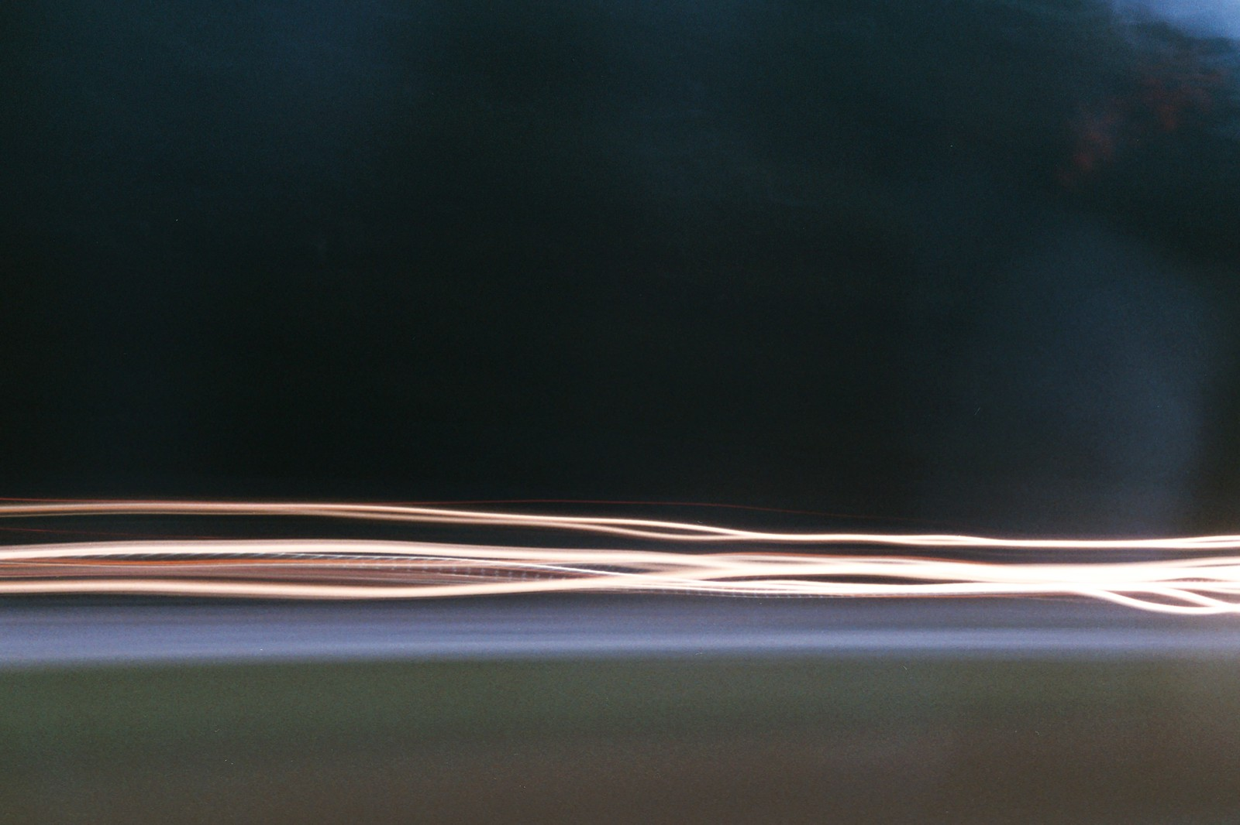
Visualization
https://jackschaedler.github.io/circles-sines-signals/dft_introduction.html

Slide 9
Fast Fourier Transform (FFT)
Used to translate time domain data in to frequency domain data
An audio file is made up of many contributing frequencies (pitches), an FFT allows you to separate and identify those contributing frequencies
A complete chord contains multiple frequencies
Waveform
Waveform (Zoomed In)

Slide 10
Background: Harmonics
When you play a note on a piano, or any natural instrument, you hear more frequencies than just the note to played. You also hear harmonics (also referred to as partials)
The 1st partial is the note played:
Partial 2: 1 octave higher 1 P8
Partial 3: 1 octave and a 5th higher 1 P5
Partial 4: 2 octaves higher 1 P4
Partial 5: 2 octaves and a M3 higher 1 M3
Partial 6: 2 octaves and a P5 higher 1 m3
Each instrument has varying amounts of each harmonic present, which is why each instrument has a unique tone.
Musical intervals used in western music were derived from the harmonic series.

Slide 11

Normalizing Power Spectral Density Data (PSD)
Once a peak was identified, it had to be mapped to the frequency that bin represents. This can be done with the following equation.
Bin Number X SAMPLERATE / NUMFRAMES
Ex.: $\frac{46 × 44100Hz}{16324 Frames}=124.271 Hz$

Slide 12
Low Pass/High Pass
A low pass filter was applied at 80Hz to the psd data to filter out low frequency noise.
A high pass filter was applied at ~2700Hz
This created a band-pass filter between 80-2700Hz, which is a realistic range for a piano.

Slide 13
Markov Model
Takes in List of chord strings from FFT
Asks the user how far back the history should be
Creates transitions, counts up their frequency
Composes song by choosing start chord randomly (Transitions would look like [$, Chord] if history is 1, [$, $, Chord] if history is 2, etc.
Then the next chord is determined using the current chord and randomly choosing from the possibility batch until the end is reached (#)

Slide 14
Transitions and Transition Count with history of 1
[['$', 'C3,E3,G3'], ['C3,E3,G3', 'E3,G3,C4'], ['E3,G3,C4', 'F3,A3,C3'], ['F3,A3,C3', 'G3,B3,F#3,D4'], ['G3,B3,F#3,D4', 'C3,E3,G3'], ['C3,E3,G3', 'C3,E3,G3'], ['C3,E3,G3', 'D3,A3,F4'], ['D3,A3,F4', 'G3,B3,D4'], ['G3,B3,D4', 'G3,B3,F#3,D4'], ['C3,E3,G3', 'C2,F3,A3'], ['C2,F3,A3', 'C3,E3,G3'], ['C2,F3,A3', 'G3,B3,F#3,D4'], ['G3,B3,F#3,D4', 'C2,F3,A3'], ['C2,F3,A3', '#']]
[1, 2, 2, 2, 4, 3, 2, 2, 2, 2, 1, 2, 2, 1]

Slide 15
Transitions and Transition Count with history of 2
[['$', '$', 'C3,E3,G3'], ['$', 'C3,E3,G3', 'E3,G3,C4'], ['C3,E3,G3', 'E3,G3,C4', 'F3,A3,C3'], ['E3,G3,C4', 'F3,A3,C3', 'G3,B3,F#3,D4'], ['F3,A3,C3', 'G3,B3,F#3,D4', 'C3,E3,G3'], ['G3,B3,F#3,D4', 'C3,E3,G3', 'C3,E3,G3'], ['C3,E3,G3', 'C3,E3,G3', 'D3,A3,F4'], ['C3,E3,G3', 'D3,A3,F4', 'G3,B3,D4'], ['D3,A3,F4', 'G3,B3,D4', 'G3,B3,F#3,D4'], ['G3,B3,D4', 'G3,B3,F#3,D4', 'C3,E3,G3'], ['C3,E3,G3', 'C3,E3,G3', 'E3,G3,C4'], ['G3,B3,F#3,D4', 'C3,E3,G3', 'C2,F3,A3'], ['C3,E3,G3', 'C2,F3,A3', 'C3,E3,G3'], ['C2,F3,A3', 'C3,E3,G3', 'C2,F3,A3'], ['C3,E3,G3', 'C2,F3,A3', 'G3,B3,F#3,D4'], ['C2,F3,A3', 'G3,B3,F#3,D4', 'C2,F3,A3'], ['G3,B3,F#3,D4', 'C2,F3,A3', 'G3,B3,F#3,D4'], ['G3,B3,F#3,D4', 'C2,F3,A3', '#']]
[1, 1, 2, 2, 2, 3, 2, 2, 2, 2, 1, 1, 1, 1, 1, 2, 1, 1]

Slide 16
Markov Challenges
Had to make dynamic allow any size of history (Added multiple start indicators, counted how many # signs and made sure it equaled amount of songs)
Needed to read in FFT .csv files correctly and prepare the song data to be exported as a midi file properly

Slide 17
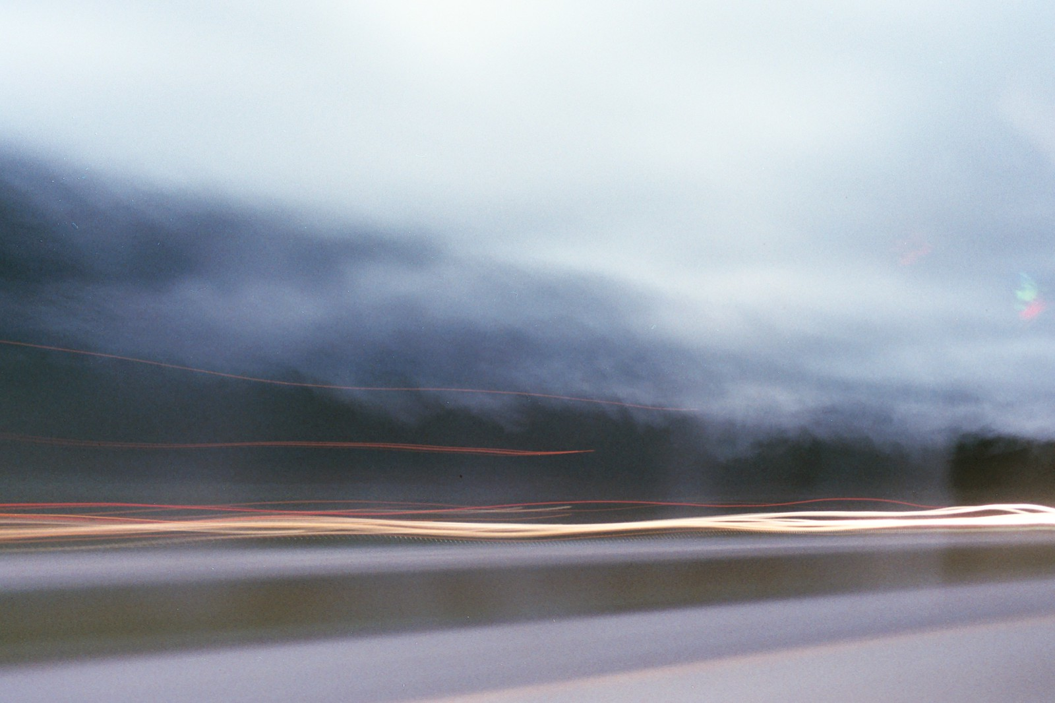
Time to listen to some Markov Music!

Slide 18
Dense Chords vs. Sparse
Dense
EM⁷ = E1, B1, E2, G#2, B2, D#2
D#m⁴₃ = G#1, D#2, F#2, A#2, C#3, D#3
G#⁶ = C2, G#2, C3, D#3
G# = G#1, G#2, C3, D#3
Sparse
EM⁷ = E1, B1, G#2, D#2
D#m⁴₃ = G#1, D#2, F#2, A#2, C#3,
G#⁶ = C2, G#2, D#3
G# = G#1, G#2, C3, D#3

Slide 19
Configurations
N-back: 3
Frames: 4096
Low-pass: 40Hz
High-pass: 2756Hz
Variable Parameter: Sparse/Dense Chords

Slide 20
Dense vs. Sparse
The FFT’s peak identification accuracy was greatly improved when sparse chord voicing were fed as input.

Slide 21
Possible Future Architectures We Explored

Slide 22
Challenges
What issues did we encounter?
Let me tell you…

